Slide 1

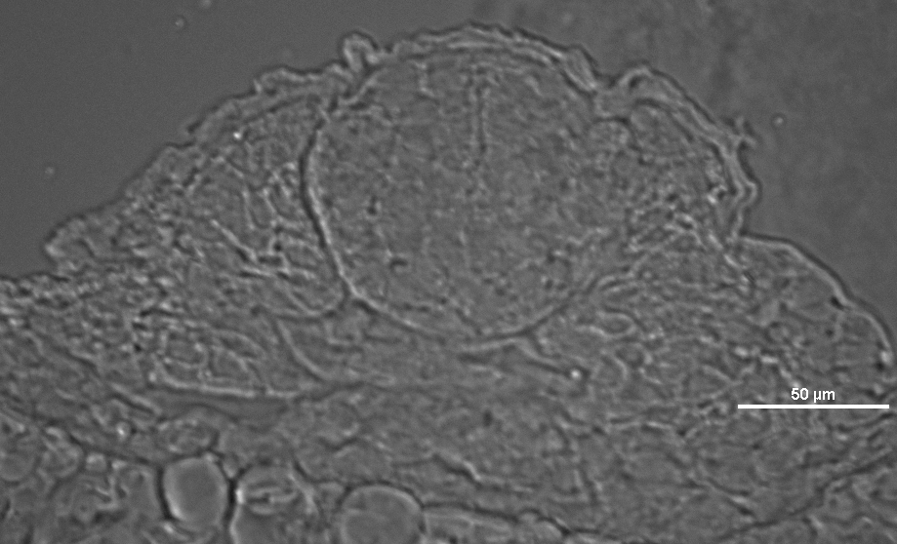
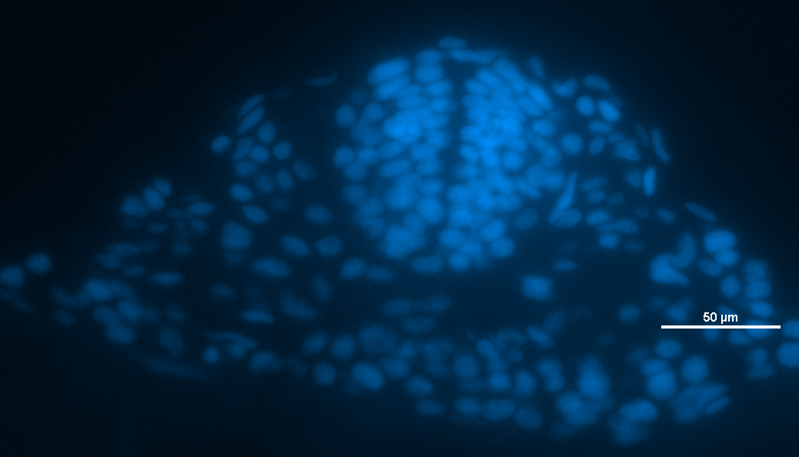
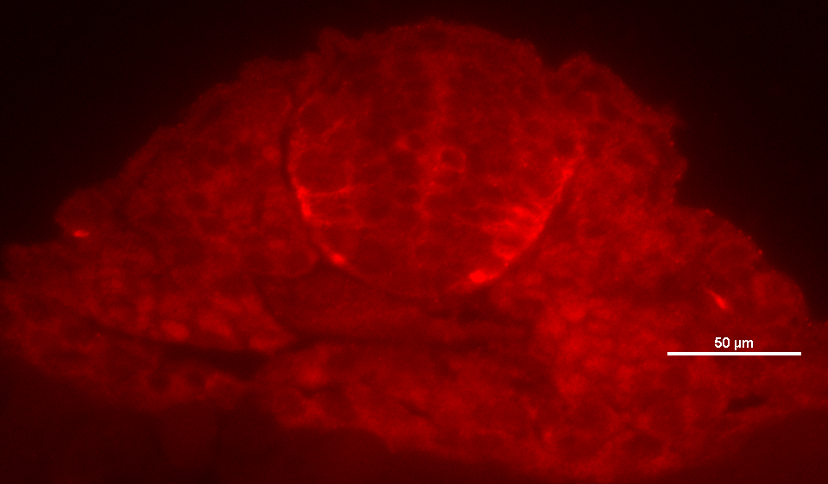
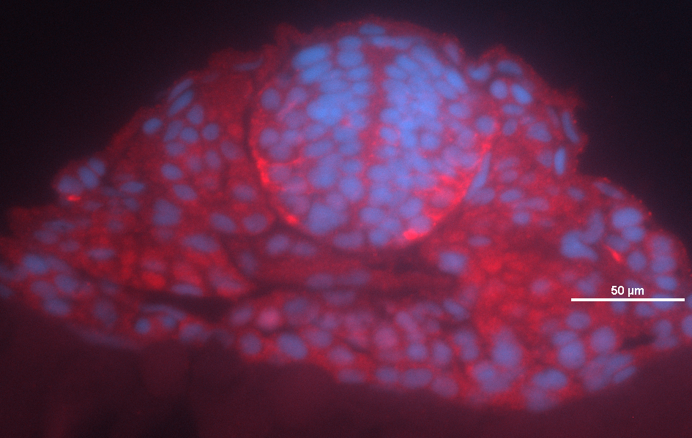
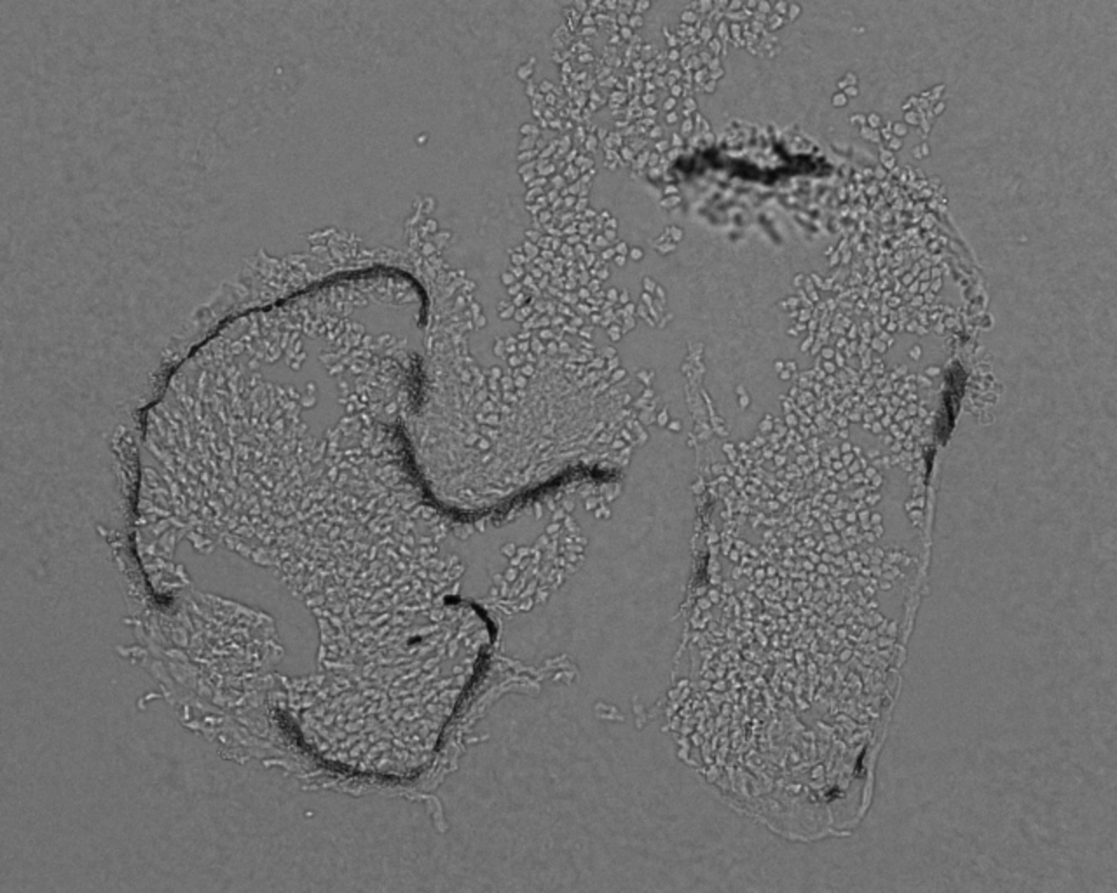
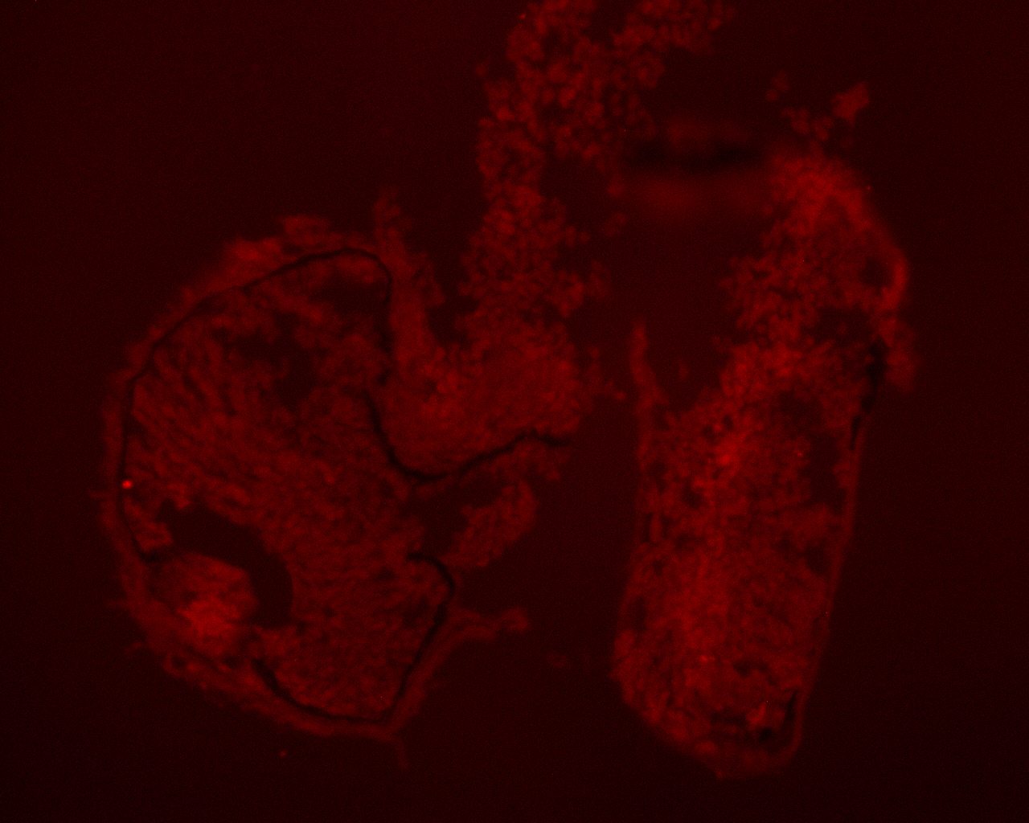
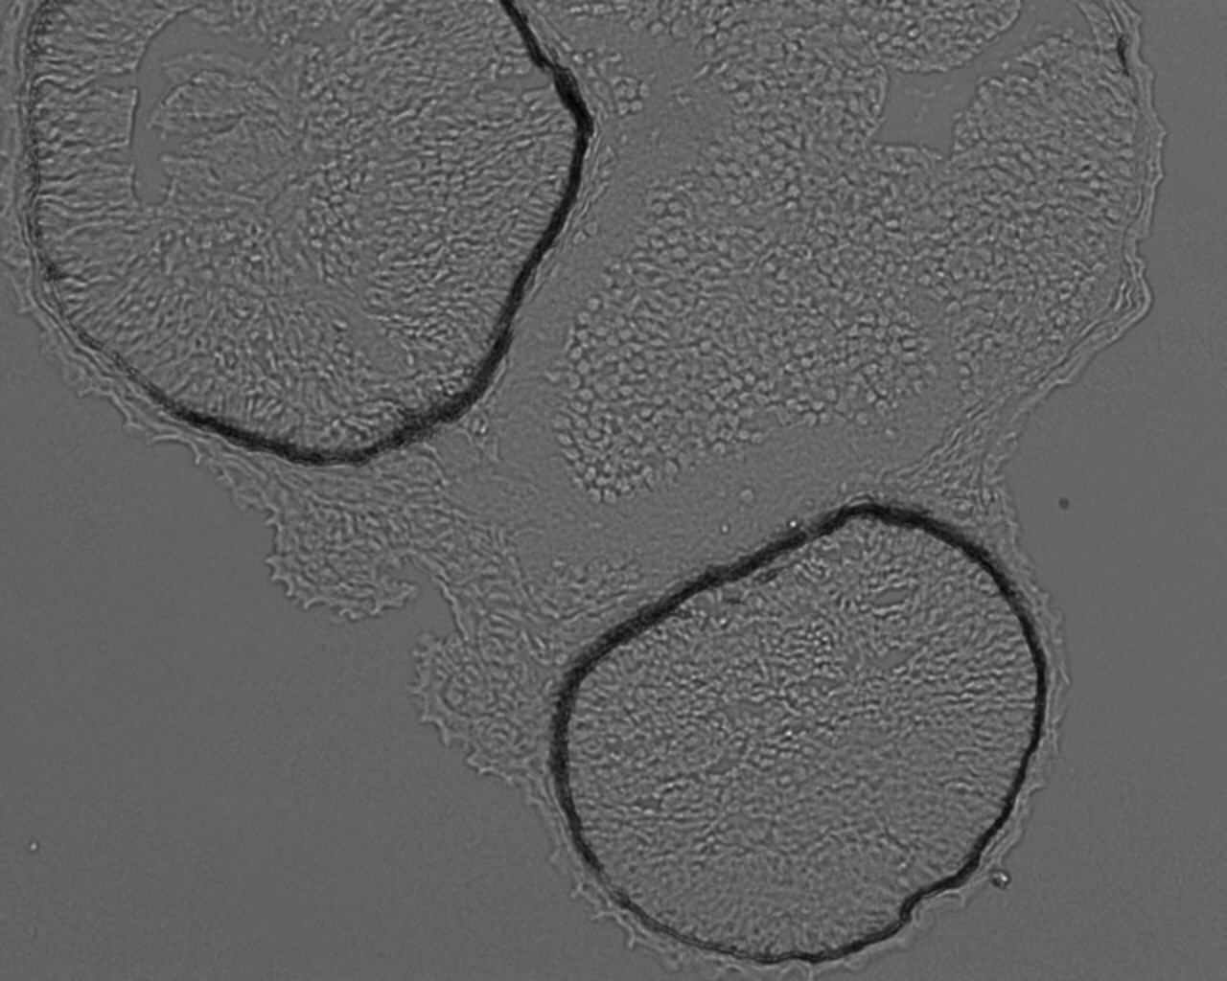
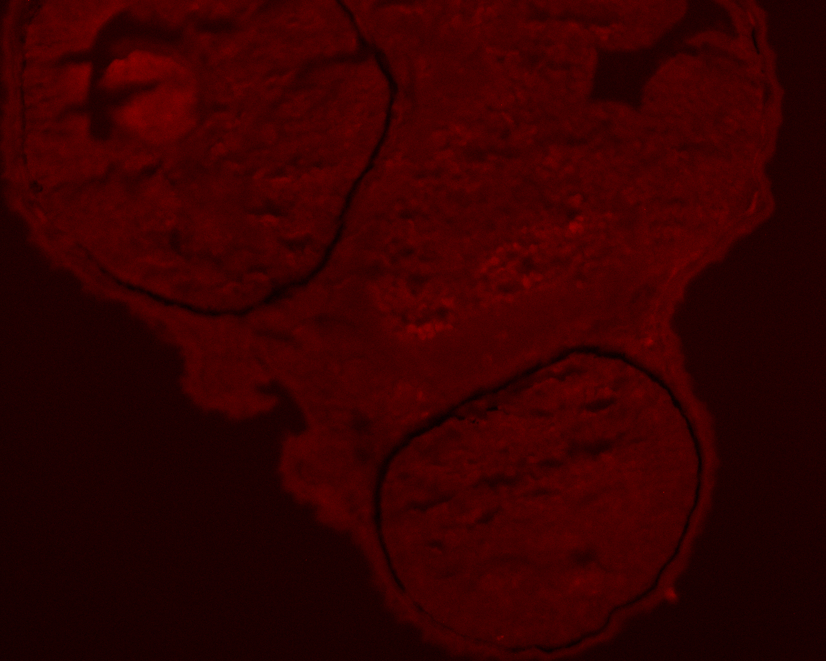
Computer Image recognition Sam Shapiro, Isabelle Pardew, and Phong Le Department of Mathematics, Goucher College, 1021 Dulaney Valley Rd., Baltimore, MD 21204
Abstract
Current progress
The highly conserved nature of vertebrate Mϋller glia makes it attractive to study the cell cycle using the model organism zebrafish (Danio rerio). Müller glia function as tissue-specific stem cells in the adult teleost retina, controlled in part by the TGFβ signaling, though the specific mechanism of this control is unknown. The TGFβ signaling pathway prevents proliferation in mammalian neural development and the creation of progenitor cells in regenerating neural tissue in Dano rerio. Signaling of the TGFβ pathway therein promotes cell cycle exit and differentiation within neural tissue. We are examining the expression of cyclin-dependent kinase inhibitors (CKI) p27 and p57 during retinal development in zebrafish. p27 and p57 are cell cycle exit markers that are expressed when progenitor cells differentiate. p27 is controlled by TGFβ, while p57 is controlled by SHH. We are examining the developmental expression of these cell cycle exit markers in wild-type fish, fish with increased TGFβ signaling (tgif1^{-/-};six3b^{-/-}), and fish with decreased TGFβ signaling (exposed to receptor kinase inhibitors). If p57 expression and differentiation are higher in cases of increased TGFβ signaling (knockdown of Tgif1 and Six3b corepressors), further studies that seek to illustrate the relation between TGFβ and p57 may be of interest. Similarly, we are examining the expression of p57 in cases of decreased TGFβ signaling (treatment with SB4, which has knockdown effects on TGFβ signaling). Preliminary studies in which p57 expression was observed in wildtype and tgif^{-/-};six3^{-/-} fish late in retinal development (60 hours post-fertilization [hpf]) showed no p57 expression in the retina. At 48 hpf retinas in the control and DMSO treatment also do not show expression in the retina. Ongoing studies are aimed at developing a complete developmental time course of p57 and p27 in the zebrafish retina in response to manipulation of TGFβ signaling.
Bright field
Hoechst
P57
P57 & Hoechst
p57
Fig. 3: Neural tube of embryo at 1 day post fertilization. P57 is seen to be either cytoplasmic or nuclear depending on current stage of cell cycle (see p57 overlay with Hoechst above). Cells seen below neural tube are part of yolk. (M. Koropsak)
Future Research
In order to better understand how the TGFβ signaling pathway regulates proliferation and differentiation in the developing vertebrate retina:
Continue determining the subcellular localization of p57 across retina development.
Further identify if TGFβ manipulations have any affect upon p57 expression.
Identify variations in p57 between cases of increased differentiation versus increased proliferation.
Identify an antibody which works well with p27 to continue study on p27.
Identify the localization of p27 across retina development.
Work to determine any affects of TGFβ on p27.
Identify any change in expression in cases of increased differentiation vs increased proliferation.
Note: ultimately, the p27 pathway is of greater interest at this time due to the fact that is more connected to the TGFβ pathway, as opposed to p57.
Fig. 1. p57Kip2 transcript expression in the zebrafish eye at 37 and 42 hpf in wildtype and Shh^{-/-} fish (fig. from A. Shkumatava, C. J. Neumann, 2005). Shh^{-/-} also has some effect on cyclin E transcript in the eye. A,C are of the most interest to the current study, illustrating p57 expression late in the development of the eye as differentiation occurs.
Methods
Bright Field
P57
All embryos were from mutant fish lines tgif1^{fh258} and six3b^{vu87} or wild type, all of which carried Tg(gfap:GFP)mi2002 to visualize the Müller glia.
Samples were taken at 1 day post fertilization (dpf), 1.5 dpf, and 2dpf.
For 1.5 and 2 dpf, embryos underwent DMSO or SB4 treatment, or no treatment, beginning at 24 hpf.
Embryos were fixed in 4% paraformaldehyde and embedded for cryosectioning.
5µm frozen sections were used for standard immunofluorescence to identify cells expressing p57 (Anti-Cdkn-1c (IN), AnaSpec, Fremont, CA to identify p57^{kip2}).
After immunofluorescence, slides were stored at room temp in the dark to be imaged within ~1 week. p57 expression and nuclei (Hoechst stain) were analyzed in the retina (NIS elements AR, ImageJ).
Control
Fig. 2. Bright field and P57 expression at 48 hpf in Tg(gfap:GFP)mi2002 control and DMSO-treatmed fish at 24 hpf. Some P57 can be detected in small regions of the head and in the lens, however there appears to be little overall expression in these cases.
Cool Questions
DMSO
The following maybe areas of interest to explore if p57 is affected in some way by TGFβ:
Further study into relation between Shh and TGFβ under these cases.
Knock-out SHH and subsequent p57 expression
Affect of alterations on p27 expression in congruence to p57
Shared p57 and p27 signaling and their affect on each other
Objectives
References
Acknowledgments
Determine if the cell cycle exit maker protein kinase c p57 is visible in fish retina at time points 1, 1.5, and 2 dpf.
Visualize the effects of manipulated TGFβ expression on p57 expression at these time points.
Hypothesis
p57 will be visible in fish retina at earlier time points, however will not be affected by TGFβ expression as p57 is controlled primarily by SHH.
P. F. Hitchcock, P. A. Raymond, The teleost retina as a model for developmental and regeneration biology. Zebrafish. 1, 257-271 (2004).
J. R. Lenkowski, P. A. Raymond, Müller glia: Stem cells for generation and regeneration of retinal neurons in teleost fish. Prog. Retin. Eye Res. 40, 94-123 (2014).
J. Massagué, TGFβ signalling in context. Nature Reviews Molecular Cell Biology. 13, 616-630 (2012).
A. Shkumatava, C. J. Neumann, Shh directs cell-cycle exit by activating p57Kip2 in the zebrafish retina. EMBO Rep. 6, 563-569 (2005).
We would like to thank Pamela Raymond (University of Michigan) for fish lines and Michael Koropsak (Goucher College) for starting the project. Funding for this project is from the Goucher College Summer Research Program (Lacy and Kurtz Funds) and NIH NEI 1R15EY027124 (JRL).
Notes:
Official Goucher colors (2014)
Blue: Pantone 2945 // CMYK: 93, 69, 20, 5 // RGB: 36, 88, 141 Gray: Pantone 7545 // CMYK: 55, 43, 36, 5 // RGB: 122, 130, 141 Yellow: Pantone: 7405 // CMYK:10, 31, 100, 0 // RGB: 232, 177, 14

